Slide 1
ACO Forum
August 25th, 2021
8:30AM-10:30AM

Slide 2
Agenda
2022 Transition to MSSP Enhanced Overview
2021 and 20221 Quality and CEHRT Requirements
Annual Wellness Visit for ACO
Closing ACO Care Gaps
HCC Coding – Recapture
CEHRT Documentation
Chronic Care Management Updates (In-House Billing)
2019 – 2021 YTD PCP Revenue Summary
Medi-Cal Enrollment Kickoff
Medicare 855R
ACO Shared Savings Distribution Plan
2022 and Beyond Strategic Approach
Updates to CMS Interim Notices
Provider Performance and Evaluation

Slide 3
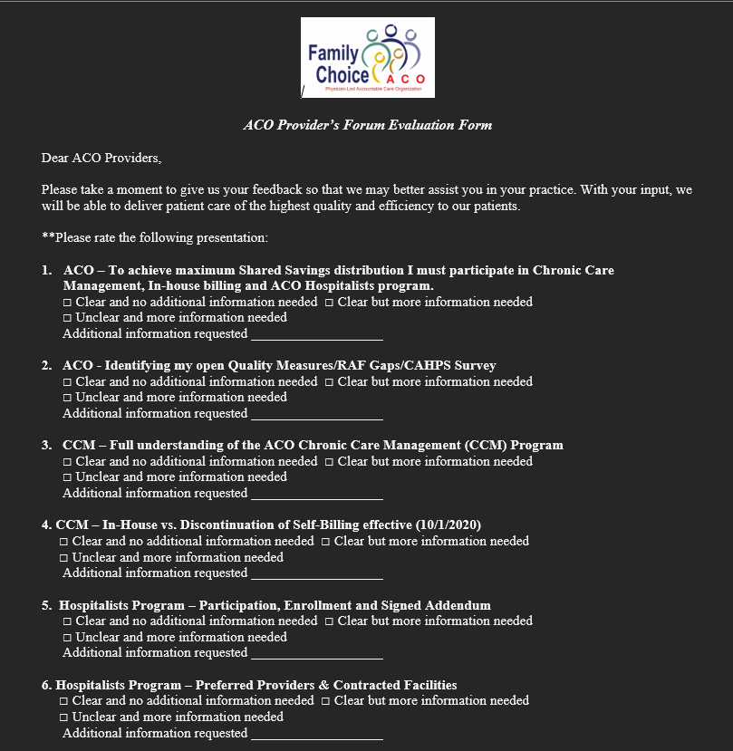

Slide 4
2021 MSSP Overview Current and Future

Slide 5
FCACO membership
YEAR | MEMBERSHIP
2018 | 6,624
2019 | 11,362
2020 | 12,204
2021 | 12,476

Slide 6
FCACO CCM MEMBERSHIP
YEAR | MEMBERSHIP
2018 | 5,097
2019 | 6,834
2020 | 7,169
2021 | 8,844

Slide 7
Year to date ACO Savings
YEAR | CMS | FAMILY CHOICE
2018 | $2,433,368 | $1,216,684
2019 | $4,390,664 | $2,195,332
2020 | Fall of 2021 | Fall of 2021
2021 | TBD | TBD

Slide 8
Sign:
ACO Participation Agreement
Chronic Care Management Program
Inhouse-Billing Addendum
ACO Hospitalists Addendum No later than 9/9/2021!!!
Complete and return Medicare Enrollment Application - Reassignment of Medicare Benefits form 855R
Commit to Medi-Cal enrollment
PY2022
DEADLINE

Slide 9
2021 MSSP Closing ACO Care Gaps

Slide 10
QUALITY MEASURES (2021)
ACO 13 - Falls: Screening for Future Falls: •CPT: 1101F(0-1 falls) •CPT: 1100F (2+falls or any fall w/injury)​
ACO 14 - Influenza Immunization​: •CPT: G8482 (Influenza vaccine administered or previously received)
ACO 17 - Tobacco Use: Screening and Cessation Intervention​: •CPT: 4004F (screened for tobacco use & received cessation intervention) •CPT: 1036F (current tobacco non-user)
ACO 18 - Screening for Depression and Follow-up Plan​: •CPT: G8431 (positive screen & f/u plan documented) •CPT: G8510(negative screen documented, f/u plan not required
ACO 19 - Colorectal Cancer Screening​: •CPT: 3017F (screening results documented & reviewed)
ACO 20 - Breast Cancer Screening​: •CPT: 3014F (results documented & reviewed)
ACO 42 - Statin Therapy - Treatment of Cardiovascular Disease​: •CPT: G9664(current statin therapy users or received a prescription for statin therapy)
ACO 40 - Depression Remission at Twelve Months​: •ICD-10(Major Depression): F33.___ •ICD-10(Dysthymia): F34.1 •CPT: G9509(remission at 12 months)
ACO 27 - Diabetes Hemoglobin A1c (HbA1c) Poor Control (>9%): •ICD-10(Diabetes): Ell.__ •CPT: 3046F(most recent HbA1c>9.0%)
ACO 28 - Hypertension: Controlling High Blood Pressure: •CPT: G8752 (Systolic BP<140mmHg) •CPT: G8754 (Diastolic BP<90mmHg)

Slide 11
2021 MSSP AWV for ACO HCC Coding – Recapture

Slide 12
HCC Coding (recapture)
1. See your patients at least once a year and bill the AWV! Due to Covid -19 this is Critical for 2022!
Diagnoses need to be captured through face-to-face encounters and reported annually.
2. Prep for patient visits ahead of time
Review ACO Care Gap report and HCC recapture report ahead of visits, so activities such as chart prep, problem list reviews can be made more effective and targeted.
3. Coding Specification
Make sure that valid diagnosis codes are documented at the time of the visit, consider options as provided in our HCC tips

Slide 13
2021 MSSP CEHRT Documentation

Slide 14
CEHRT Documentation
1. Please instruct staff to respond timely to ACO data support team.
2. Annually request a CEHRT Use letter from your EHR vendor and supply to FCACO.
3. Audits are random by CMS so be prepared.

Slide 15
CCM Operations Overview

Slide 16
CCM Facts and More Top Performers
# | PROVIDER NAME | AMOUNT TO PROVIDERS
1 | PCP | $147,620.04
2 | PCP | $92,129.68
3 | PCP | $62,633.00
4 | PCP | $57,621.86
5 | PCP | $54,683.74
6 | PCP | $49,672.22
7 | PCP | $41,818.30
8 | PCP | $39,701.69
9 | PCP | $21,208.29
10 | PCP | $19,736.55
80 providers participating. Are you missing out?

Slide 17
Evaluation of Top Performers
Providers | 2018 Shared Savings | 2018 Advanced Payment Model | 2018 CCM Program | Total
PCP | $22,459 | $26,952.83 | $1,689.58 | $51,101.41
PCP | $15,033 | $11,734.21 | $0.00 | $26,767.21
PCP | $6,550 | $41,255.44 | $0.00 | $47,805.44
PCP | $7,394 | $19,316.62 | $0.00 | $26,710.62
PCP | $11,966 | $0.00 | $234.94 | $12,200.94
PCP | $10,981 | $10,978.82 | $729.31 | $22,689.13
PCP | $6,263 | $11,991.87 | $538.98 | $18,793.85
PCP | $5,830.00 | $11,032.51 | $0.00 | $16,862.51
PCP | $0.00 | $0.00 | $0.00 | $0.00
PCP | $0.00 | $0.00 | $0.00 | $0.00
Providers | 2019 Shared Savings | 2019 Advanced Payment Model | 2019 CCM Program | Total
PCP | $50,984.12 | $0.00 | $9,168.32 | $60,152.44
PCP | $38,667.95 | $0.00 | $0.00 | $38,667.95
PCP | $14,827.56 | $0.00 | $0.00 | $14,827.56
PCP | $22,668.11 | $0.00 | $1,679.95 | $24,348.06
PCP | $27,878.17 | $0.00 | $0.00 | $27,878.17
PCP | $22,770.55 | $0.00 | $4,053.89 | $26,824.44
PCP | $20,691.08 | $0.00 | $2,296.94 | $22,988.02
PCP | $18,399.18 | $0.00 | $108.45 | $18,507.63
PCP | $15,986.56 | $0.00 | $0.00 | $15,986.56
PCP | $19,736.55 | $0.00 | $0.00 | $19,736.55
Providers | 2020 Shared Savings | 2020 Advanced Payment Model | 2020 CCM Program | Total
PCP | $0.00 | $0.00 | $36,366.19 | $36,366.19
PCP | $0.00 | $0.00 | $26,694.52 | $26,694.52
PCP | $0.00 | $0.00 | $0.00 | $0.00
PCP | $0.00 | $0.00 | $6,563.18 | $6,563.18
PCP | $0.00 | $0.00 | $14,604.63 | $14,604.63
PCP | $0.00 | $0.00 | $158.66 | $158.66
PCP | $0.00 | $0.00 | $36.43 | $36.43
PCP | $0.00 | $0.00 | $4,331.55 | $4,331.55
PCP | $0.00 | $0.00 | $5,221.73 | $5,221.73
PCP | $0.00 | $0.00 | $0.00 | $0.00

Slide 18
In-House Billing
How will Family Choice ACO CCM In-house Billing Work?
Patient Care Coordinators (PCCs) will continue to enroll eligible patients and create comprehensive care plans as they do daily.
FC ACO will aggerate for all eligible monthly charges and bill Medicare directly.
FC ACO will invoice PCP 50% of CCM allowed amount for performing monthly CCM services
FC ACO will make monthly disbursements to providers along with a copy of summary of EOBs for your records.
FC ACO will bill only one of the below CPT codes monthly.
99490
99487
99489

Slide 19
Sign ACO Participation Agreement Addendum – Chronic Care Management Program
Complete and return Medicare Enrollment Application - Reassignment of Medicare Benefits form 855R
Commit to Medi-Cal enrollment
How can I participate?

Slide 20
Provider Performance and Evaluation Shared Savings distribution plan PY2021
Three-part shared savings distribution plan
HCC coding recapture
Quality performance
ACO Program Participation
CCM opt in
CCM In-house Billing opt in
ACO Hospitalist opt in
FCACO will plan to distribute in next 30-45 days from receipt of payment from CMS.

Slide 21
2021 MSSP CEHRT Documentation

Slide 22
2022 and Beyond Strategic Approach: Updates to CMS Interim Notices Direct Contracting Primary Care First Other CMs Models

Slide 23
2021 & 2022 MSSP Overview
1. FCACO will remain in current MSSP track through 12/31/2021.
2. FCACO will renew ACO under MSSP Enhanced Track. Greater risk pool means bigger distribution pool paid to providers.

Slide 24
FCACO Shared Saving Models
Overlap with Primary Care First and Direct Contracting Model will not be permitted in 2022.
PCPs will need to select by 9/10/2021 or PCP will be terminated from ACO program and lose shared savings distribution opportunity.
PCF only offers minimal professional bonuses – ACO is TOTAL COST OF CARE! PCF adjusts the PBP by a factor ranging from -10% to +50% based entirely on acute hospital utilization (AHU). ACO only 75% UPSIDE!!!!
PCF requires additional quality reporting on all patients in practice!
ACO reduces additional administrative burden of PCF! Participants are subject to a program integrity screening and must submit cost, utilization, patient experience, and quality data to ensure patient safety and compliance.

