Slide 1
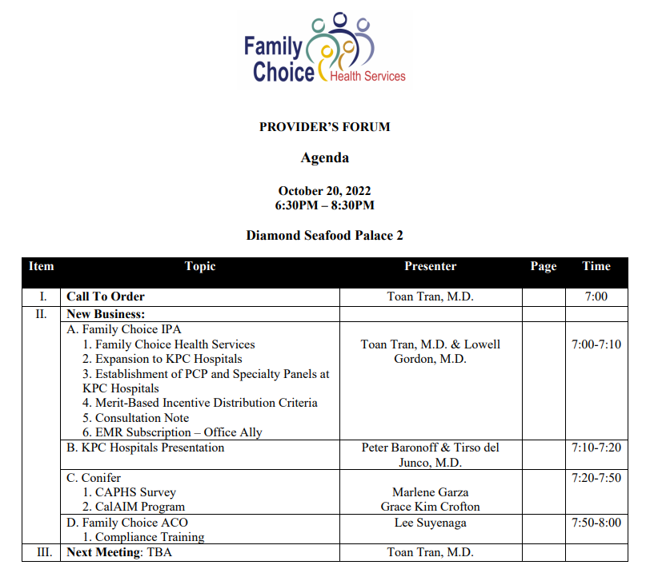

Slide 2
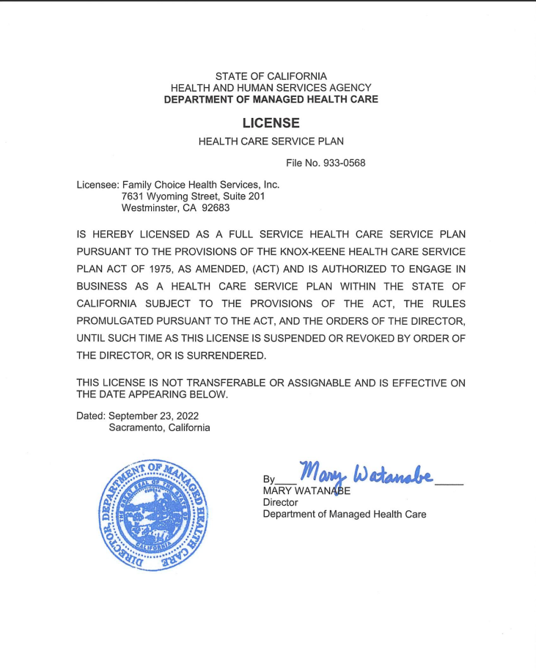

Slide 3
AGENDA
Family Choice Health Services (FCHS)
Expansion to KPC Hospitals
Establishment of Primary Care Physicians (PCP) and Specialty Panels at KPC Hospitals
Merit-Based Incentive Distribution Criteria
Consultation Note
EMR Subscription—Office Ally

Slide 4
FAMILY CHOICE HEALTH SERVICES
Family Choice (FC) has been approved for a Restricted Knox-Keene License (RKK)
Allows Family Choice to assume Institutional (Hospital) capitation in addition to professional cap
CalOptima signed a global contract with Family Choice Health Services for MediCal under this new RKK arrangement
Fountain Valley Regional Hospital role changed from financial control of Institutional pool to network partner allowing Family Choice to expand Hospital network
Other contracts (OneCare, Medicare Advantage) to follow

Slide 5
EXPANSION TO KPC HOSPITALS
Recognizing that Family Choice has grown geographically beyond the Fountain Valley Regional Hospital catchment area, the need for an expanded hospital network has been a Family Choice priority
RKK now allows Family Choice to add additional hospitals to the network
Contracting with KPC will add the following hospitals:
Orange County Global: N. Tustin Ave., Santa Ana
South Coast Global: S. Bristol Ave., Santa Ana
Anaheim Global: S. Anaheim Blvd., Anaheim
Chapman Global: E. Chapman Ave., Orange

Slide 6
EXPANSION OF PRIMARY CARE PHYSICIANS (PCP) AND SPECIALTY PANELS
Adding KPC to the network will address the significant “leakage” to UCI that adds unnecessary utilization
This strategy will only be effective if Family Choice has a robust PCP and Specialty network to meet the needs of the patient population that resides close to UCI
Reducing the use of the UCI ED is imperative for Family Choice to continue to have financial success as capitation rates for the MediCal Expansion population (ObamaCare) continues to contract

Slide 7
MERIT-BASED INCENTIVE DISTRIBUTION CRITERIA
Exclusivity
Capitation
Performance
Encounter Data
Risk Adjustment Factors (RAF) Score
HEDIS Score
Electronic Health Record (EHR)

Slide 8
CONSULTATION NOTE
Coordination of care is only going to be successful if PCPs have consult notes from Specialists
Improving Risk Adjustment (RAF) scoring for Senior members depends upon PCPs adding Specialists diagnoses to PCP medical records
Family Choice could supply a list of PCP fax numbers to Specialist if that would facilitate

Slide 9
THREE-YEAR OFFICE ALLY SUBSCRIPTION
Family Choice will pay three-years of Office Ally subscription for those who move from paper chart to EMR (certain criteria applied)
Chart review by health plans is only going to increase and review of paper records is laborious and expensive to all parties involved
Medical-legal concerns should motivate everyone to be electronic
Please contact Family Choice for more information

Slide 10
Q & A SESSION

