Slide 1
Provider’s Forum
October 13, 2023

Slide 2
Notes:
FCHS Board of Directors and Officers

Slide 3
Notes:
FCHS Board of Directors and Officers

Slide 4
Notes:
FCHS Board of Directors and Officers

Slide 5
Notes:
FCHS Board of Directors and Officers

Slide 7
AGENDA
TOPIC | PRESENTER | PAGE | TIME
Call To Order | Toan Tran, M.D. |  | 7:00
A. Introduction 1. IPA Merit-Based Incentive Distribution 2. ACO Shared Savings | Toan Tran, M.D. |  | 7:00-7:30
B. OneCare Benefits | Lucie Nguyen |  | 7:30-7:45
C. Annual Wellness Exam | Grace Kim Crofton |  | 7:45-8:00
D. Compliance Training | Renee Kimm & Tammy Duong |  | 8:00-8:30

Slide 8
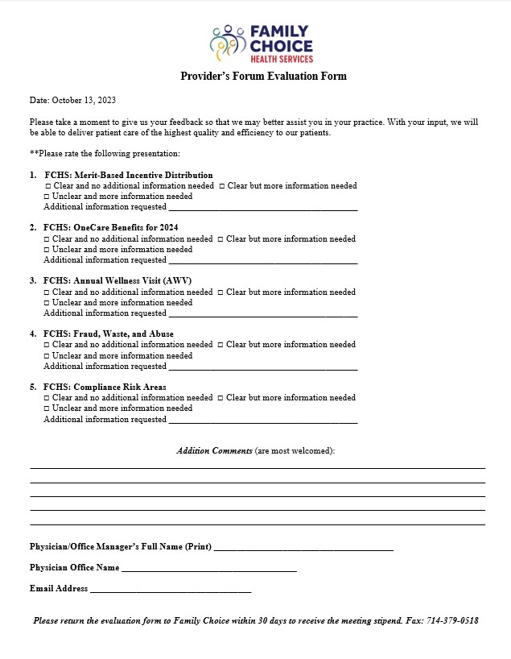
EVALUATION FORM
Please fill out the evaluation form and return to Family Choice within 30 days to receive the meeting stipend.

