Slide 1
OneCare (HMO D-SNP), a Medicare Medi-Cal Plan 2024 Benefits

Slide 2
OneCare Sales Representative Contact
Lucie T. Nguyen
Senior Community Partner
714-246-8841
lnguyen@caloptima.org
I am state-licensed and authorized as a Sales Representative for OneCare Health Plan
I do not represent any branch of the federal or state government

Slide 3
Who is CalOptima Health?
CalOptima Health was founded by the community as a County Organized Health System that offers health insurance programs for low-income children, adults, seniors and people with disabilities
As Orange County’s largest health insurer and as a public and non-profit agency, CalOptima Health was created by and for the community, serving nearly one million low-income children, adults, seniors and people with disabilities for over 28 years
“Better. Together.” is our motto, and it means that by working together, we can make things better for our members and community

Slide 4
CalOptima Health Recognitions & Awards
Top Rated Medi-Cal Plan in California: NCQA Achievement: For the ninth year in a row, CalOptima Health is a top Medi-Cal plan in California, receiving a score of 4 out of 5 in the National Committee for Quality Assurance (NCQA) Medicaid Health Plan Ratings 2022

Slide 5
OneCare (HMO D-SNP), a Medicare Medi-Cal plan

Slide 6
What is OneCare?
OneCare (HMO D-SNP), a Medicare Medi-Cal plan, is CalOptima Health’s Medicare Advantage plan for Medi-Medi members and has been serving the dual population since 2005
CalOptima Health’s OneCare webpage: www.caloptima.org/OneCare
OneCare is available to Medi-Medi members who reside in Orange County
OneCare coordinates members’ Medicare, Medi-Cal and Medicare Part D (prescription coverage) through ONE single plan to make them easily accessible to duals
OneCare offers supplemental services and care coordination with no copays

Slide 7
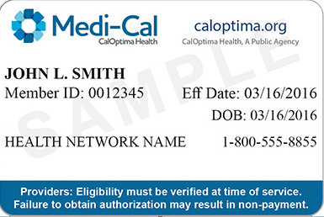
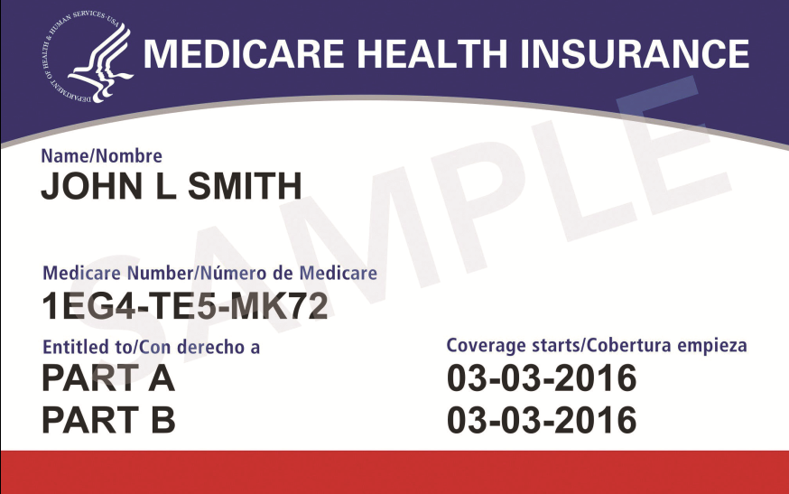
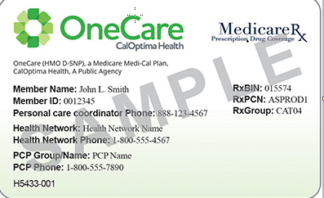
OneCare Eligibility
To become a member of OneCare, a member must be:
Age 21 and older
Living in Orange County
Enrolled in Medicare Parts A and B
Receiving Medi-Cal benefits

Slide 8
2024 Benefit Highlights (cont.)
General Benefits and Services
Benefit | Covered | Cost
Nurse advice line | Yes | $0
Contracted primary care provider (PCP) and specialist services | Yes | $0
Lab tests | Yes | $0
X-rays | Yes | $0
Durable medical equipment | Yes | $0
Flu shots | Yes | $0
Screening mammograms | Yes | $0
Pap tests and pelvic exams | Yes | $0
Prostate cancer screening exams | Yes | $0
Bone mass testing | Yes | $0
Notes:
In addition, you will have access to CalOptima Health’s Nurse Advice Line 24 hours a day, 7 days a week. You can call the Nurse Advice Line with questions about your health or health care by calling 1-844-447-8441 (TTY 1-844-514-3774).

Slide 9
2024 Benefit Highlights (cont.)
General Benefits and Services
Benefit | Covered | Cost
Diabetic supplies and podiatry services | Yes | $0
Mental health services (inpatient and outpatient) | Yes | $0
Physical and occupational therapy | Yes | $0
Chiropractic and acupuncture services | Yes | $0
Medical equipment and supplies | Yes | $0

Slide 10
2024 Benefit Highlights (cont.)
Live Safely at Home
Benefit | Covered | Cost
Orange County In-Home Support Services (IHSS) + Companion Care | Yes | $0
Community-Based Adult Services (CBAS) | Yes | $0
Long-Term Care (LTC) | Yes | $0
Hospital Services
Benefit | Covered | Cost
Hospital care and surgeries | Yes | $0
Emergency room services | Yes | $0
Outpatient hospital services | Yes | $0
Ambulance services | Yes | $0
Skilled nursing facility and home health care | Yes | $0
Notes:
Different and separate benefit from IHSS is our Companion care as a supplemental benefit (90 hours per year)
Help with non-medical activities of daily living (e.g., assisting members with transportation, light housework, companionship, technology assistance, exercise, and grocery and medication deliveries, etc.) – PAPA Pals

Slide 11
2024 Benefit Highlights
OneCare (HMO D-SNP), a Medicare Medi-Cal Plan, combines your Medicare and Medi-Cal benefits in a single plan!
OneCare offers complete health care including:
Prescription
medicines
OTC
medicines
Vision care through VSP providers
Hearing
services
Fitness
benefits
Unlimited
transportation
Worldwide emergency care
Companion
care
Annual physical examination
Dental services from Medi-Cal Dental
Notes:
RX = zero copays throughout the year for generic and brand name meds
OTC = increased from $80 to $100 quarterly allowance
Vision = $250 every year for contacts or lenses
Hearing $1,000 above the Medi-Cal limit of $1,510
Fitness Benefit + unlimited trans to/from gym
Worldwide ER or Urgent care - $100K per year
Companion Care – 90 hours per year to help with activities of daily living (non-medical services) such as companionship and assisting members with transportation, light housework, technology, exercise, grocery shopping and medicine deliveries, etc.
Annual Physical Examination - With this benefit, you are covered for <1> routine physical examination per <year>. This exam includes screening laboratory services as needed.
Dental Benefits - available under your Medi-Cal Dental Program. Some of the dental services available to you are initial examinations, X-rays, cleanings, fluoride treatments, restoration and crowns, root canal therapy, dentures, adjustments, repairs and relines. For more information, or if you need help finding a dentist who accepts the Medi-Cal Dental Program, contact their Customer Service Line at 1-800-322-6384. Dental service representatives are available to assist you from 8 a.m. to 5 p.m., Monday through Friday. You can also visit their website at SmileCalifornia.org for more information.

Slide 12
Benefit: Pharmacy
Members have zero co-pays throughout the year
Medication Type | Covered | Your Co-Pay
Initial Coverage Stage Until your total out-of-pocket costs reach $8,000
Formulary Generic Drugs | Yes | $0
Formulary Brand-Name Drugs | Yes | $0
Catastrophic Coverage Stage After your total out-of-pocket costs reach $8,000
Formulary Generic Drugs | Yes | $0
Formulary Brand-Name Drugs | Yes | $0

Slide 13
Benefit: Over-the-Counter (OTC) Benefit
Vendor: Convey Health Solutions
Benefit summary: Allows members to use up to $100 per quarter (no rollover) to purchase items from the OTC catalog and shipped directly to member
Eligible, non-prescription items are listed in the OTC catalog sent to members upon enrollment and annually
Members may order items:
Online by visiting and registering on Convey’s website, caloptima.conveyotcsolutions.com
By calling Convey’s Customer Service at 1-855-299-5410, Monday-Friday from 5:00 AM to 8:00 PM.
By Mail, the order form is attached in the catalog, and is also available on CalOptima’s website, www.caloptima.org

Slide 14
Benefit: Vision Care
Vendor: Vision Service Plan (VSP)
Benefit summary:
One routine eye exam every year
Glaucoma screening
Plan payment of up to $250 above the Medi-Cal limit, every year for eyeglasses or contact lenses
Customer Service warm transfers members to VSP Customer Service, 1-800-877-7195 for assistance in locating a provider

Slide 15
Benefit: Hearing
Benefit summary: CalOptima Health will pay up to $1,000 above the state Medi-Cal limit of $1,510 per fiscal year for hearing aids including molds, modification supplies and accessories
Amount may be used for one ear or for two ears
Benefit may only be used once during the calendar year
Prior authorization is required

Slide 16
Benefit: Fitness Benefit
Vendor: ASH/Silver & Fit
Benefit summary:
Membership to a contracted gym and one home fitness kit
An exercise and healthy aging program designed specifically for OneCare members.
8,000+ on-demand videos through the website and mobile app digital library, including the Silver & Fit Signature Series Classes®.
Healthy Aging Coaching sessions by telephone with a trained coach where members can discuss topics like exercise, nutrition, social isolation, and brain health.
The Silver & Fit Connected™ tool for tracking activity.
Online Healthy Aging classes.

Slide 17
Benefit: Transportation
Vendor: Modivcare
Benefit Summary: Unlimited trips per year to plan-approved medical services, such as:
Doctor visits, labs or X-rays, hospital and pharmacy
As a supplemental benefit, unlimited transportation is also available for trips to and from the gym
To ask for a ride for services that have been authorized, members at 1-866-612-1256 (TTY 711) at least two business days (Monday-Friday) before the appointment

Slide 18
Benefit: Worldwide Coverage
Benefit oversight: Customer Service
Benefit summary: CalOptima Health will reimburse a member up to $100,000 per year for emergency and urgent care and transportation received outside the United States and its territories.
Members must pay for the services rendered upfront and submit medical documentation and proof payment to CalOptima Health
Emergency and urgent care is given to treat:
A condition that needs immediate medical care
A sudden medical illness
An injury
Note: Services are covered worldwide under the same conditions of medical necessity and appropriateness that would have applied if the same services were provided within the United States.

Slide 19
Benefit: Companion Care
Vendor: Papa
Benefit summary: Allows access to up to 90 annual hours of help with instrumental activities of daily living including:
Transportation, light house help, companionship, technical guidance, exercise, and grocery and medication deliveries
Members may request the service for themselves
Papa reviews eligibility and conducts assessment
Papa visit scheduling lead time is 72 hours.
During each visit, the care provider (Papa Pal) provides the services based on the task requested and provides notes on the visit, including any concerning elements observed

Slide 20
Benefit: Physical Exam (NEW)
Benefit summary: For CY 2024, we’ve added Physical Exams as a supplemental benefit.
The plan covers one physical exam per year as full assessment of the member’s health, including laboratory services, as needed.
The plan covers an annual wellness visit to make or update the member’s care plan to help prevent illness.
We pay for one annual wellness visit every 12 months.

Slide 21
Member’s Benefits Integrated
Specialist
Care
Primary Care
Hospital Services
Medicare
Behavioral Health
Short-Term
Nursing Care
Medi-Cal
Member
Physical/ Occupational/ Speech Therapy
Home Health
OneCare (HMO D-SNP)
Dialysis
Hospice
Medications
Durable
Medical
Equipment
Long-Term Nursing Care
Some Durable Medical Equipment
Personal Care Coordinator
In-Home
Supportive
Services
Nonemergency Medical Transportation
Multipurpose
Senior Services Program
Specialty
Mental Health
Community-Based Adult Services
OTC, Rx, Vision Care, Fitness Benefit, Companion Care, Hearing, & Worldwide Coverage
Medi-Cal Dental Services

Slide 22
Summary
CalOptima Health’s OneCare is a health plan in Orange County that puts Medicare and Medi-Cal benefits together since 2005
For more information
Visit www.caloptima.org/OneCare
Care team and care plan
Personal care coordinator
Home and community services
Member
Doctors and specialists
We love referrals! Please contact us if you have family or friends who could benefit from OneCare.

Slide 23
Q&A

Slide 24
Disclaimers
OneCare (HMO D-SNP), a Medicare Medi-Cal Plan, is a Medicare Advantage Organization with a Medicare contract. Enrollment in OneCare depends on contract renewal
OneCare complies with applicable federal civil rights laws and does not discriminate on the basis of race, color, national origin, age, disability or sex. Members may call our Customer Service toll-free at 1-877-412-2734 (TTY 711), 24 hours a day, 7 days a week. Visit us at www.caloptima.org/OneCare
This is not a complete list. The benefit information is a brief summary, not a complete description of benefits. For more information, visit our website and read the OneCare Member Handbook. Limitations, co-pays and restrictions may apply. Benefits and/or co-payments may change on January 1 of each year

