Slide 1
Family Choice medical group PROVIDER FORUM Quality improvement Strategy October 13, 2023

Slide 2
2023 Medicare HMO Annual Wellness Visit Program CalOptima OneCare Blue Shield Senior (In Office Assessment) Brand New Day Central Health Plan Health Net Seniority Plus NOT to be confused with CalOptima’s AWV for Medi-Cal members 45+ years! NOT to be confused with Medicare ACO

Slide 3
Medicare HMO 2023 Annual Wellness Visits
Requirements to earn bonus incentive
Claims/encounters along with patient chart received within 70 days of DOS - incentive payment will be calculated from administrative data only
Patient chart documentation and claims submissions must support at least 80% of chronic condition and/or quality “gaps” indicated on the form.
You do not need to fill out the form – use it as a guide/roadmap
DO make sure your biller is submitting all the codes via CMS 1500: ICD-10 (for dx) and procedure codes for quality services
Reminder: Annual Wellness Visit forms – prepopulated for member specific conditions (previously submitted diagnoses), qualifying quality care gaps and demographics. Email qualityprograms@coniferhealth.com if you cannot access
---------
Example 1 - Quality bonus incentive for provider with 10 Medicare HMO Patients who successfully complete 10:
$250 x 10 = $2500; $50 x 10 or $500 to office staff
Example 2 - for 25 patients:
$250 x 25 = $6250; $50 x 25 or $1250 to office staff

Slide 4
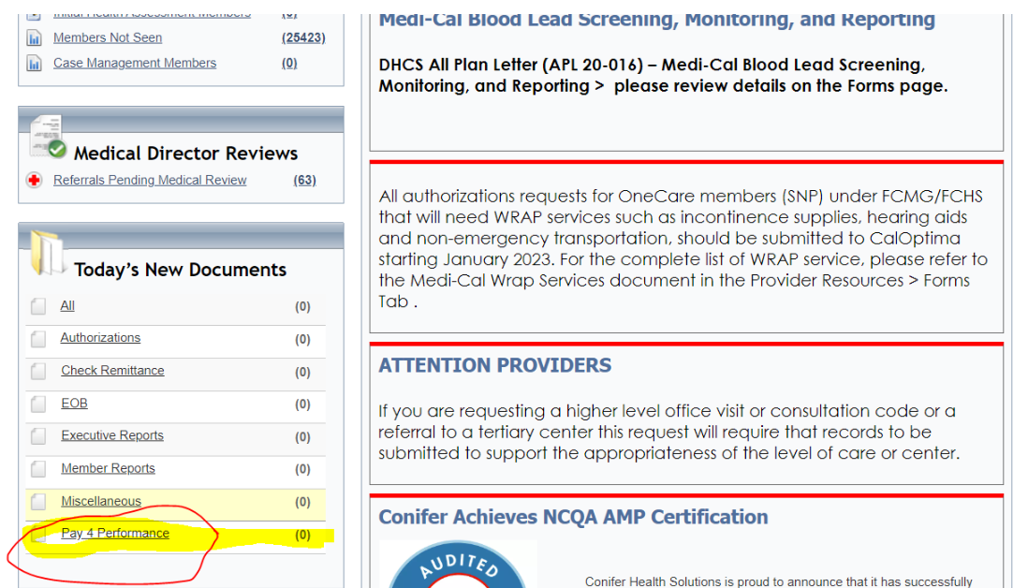
Retrieving 2023 Pre-Filled/Mbr Customized AWVs and Shortage Reports – Conifer Provider Portal: CAP CONNECT
Uploaded to Conifer Provider Portal, CAP Connect, on 4/4/2023 and Fax’d to provider offices. Some emailed

Slide 5
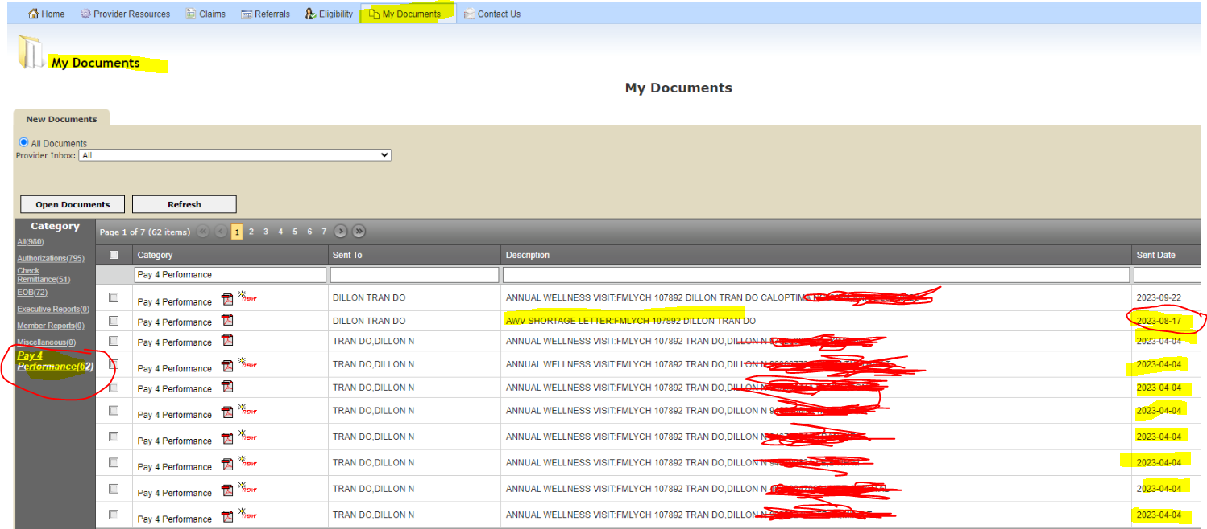
Retrieving 2023 Pre-Filled AWVs and Shortage Reports – CAP CONNECT

Slide 6
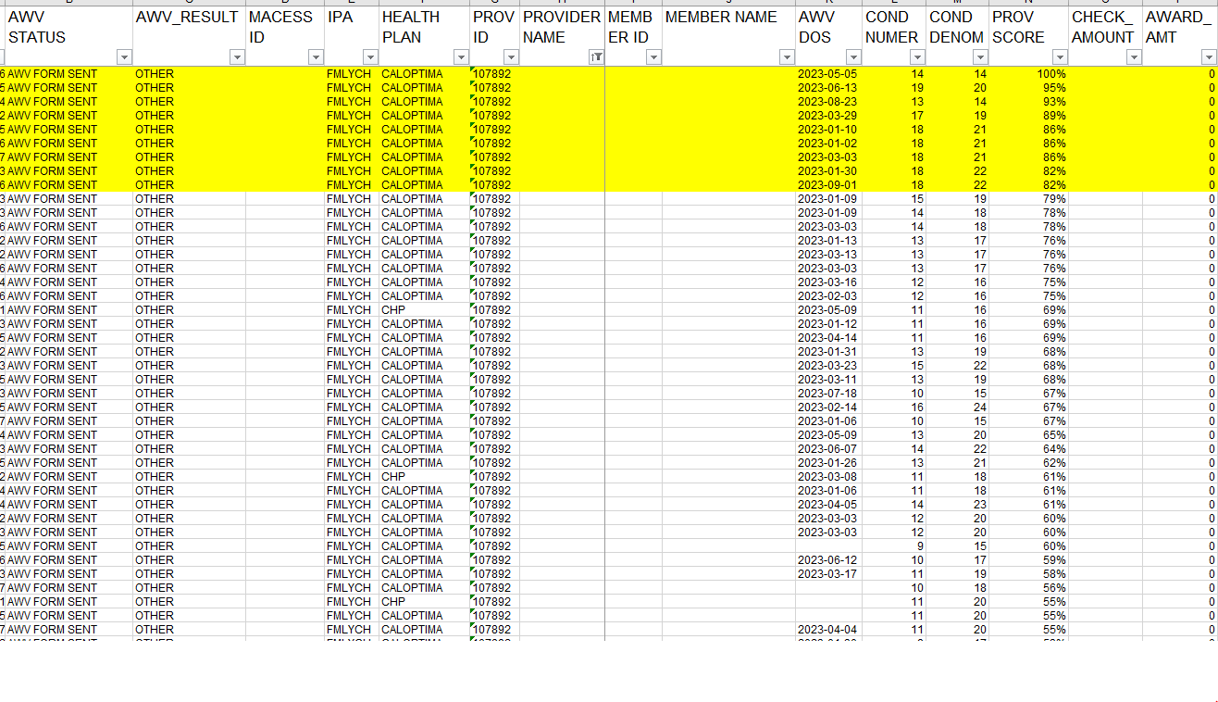
Medicare HMO AWV Payment Report – highlighted indicates 80% or greater but need patient charts fax’d over to 818-817-5181; 60 Mbrs → $15,000 in bonus incentives

Slide 7
RECAP: 2023 Medicare AWV– Submission/Incentive Pay Requirements. $250 per member
Include the following when submitting an assessment:
Complete, sign, and date first page of the AWV and/or submit with the supporting patient chart for any and all visits in 2023. Fax Number 818-817-5181
Submit claim/encounter following the regular claims submissions workflow to Conifer within 70 days from DOS. The record must contain a G code.
G0438 for initial Wellness Visit; G0439 for subsequent Wellness Visit
Incentive payment will be calculated from administrative data only - CLAIMS
Submit ALL ICD-10 Diagnosis codes – this is very important as it impacts member’s RAF score and procedure codes (HCPCS, CPT-4, CPTII, LOINC) – this impacts HEDIS/Stars scores and plan quality incentive
Accompanying medical record MUST meet all coding and documentation standards including:
Provider name, credentials, signature, and date signed must appear at the end of each documented patient visit in the medical record
Patient name, date of birth, and date of service must be included on every page

Slide 8
QUESTIONS? LET US KNOW!! Qualityprograms@coniferhealth.com Grace Kim Crofton, Director QI Strategy 310-340-5669 grace.kimcrofton@coniferhealth.com Rodney Truong, Manager QI (818) 817-5626 Rodney.Truong@coniferhealth.com

Slide 9
ADDITIONAL INFO/Reports

Slide 10
New Medicare HMO AWV Program 2023 Per member incentive: $250 ($50 to office manager)
Distributed to provider offices 4/3/2023. Uploaded to CapConnect; fax’d and emailed.
Office staff training sessions going over new program – March and April 2023
Each form pre-filled with member’s:
disease conditions
qualifying preventive and chronic care services needed (based on HEDIS/Stars)
Section 1: Diagnoses
Chronic conditions diagnosed in prior year, must be assessed and documented again for 2023 CY and ICD-10 submitted via claims.
Conditions must be documented to the highest degree of specificity in the patient’s medical record
Sections 2 & 3: applicable quality measures – all part of routine senior care
HEDIS quality, Medication Adherence, Care for Older Adults and HOS (assessment for urinary incontinence, fall risk, physical activity), behavioral health and cognitive assessment
The medical record documentation must meet CMS/NCQA requirements, including provider signature and credentials, patient name, and date of service.

Slide 11
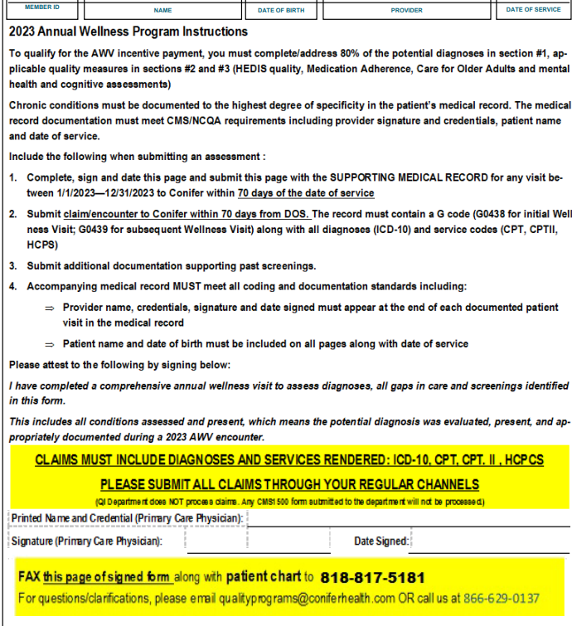
First Page of AWV Form – Instructions

Slide 12
Shortage Report: Member Example
The following slides are our findings while reconciling the Shortage Report Item(s) vs
Progress Notes and Claims to identify opportunities to reach the 80% for this member.

Slide 13
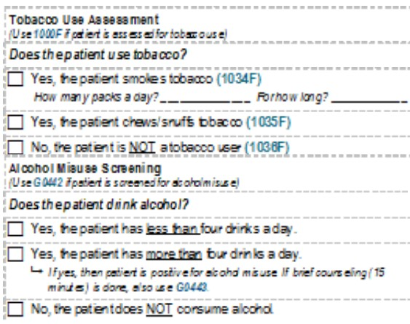
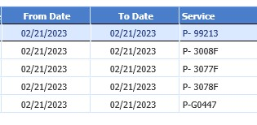
Shortage Report Item(s):
Alcohol / Tobacco / Physical Activity
ADDRESSING THESE
WOULD’VE ADDED
3 POINTS TO THE SCORE
MOVING IT TO………
75%
Section from the AWV form:
Social History portion from Progress Note:
Pg 2
ALCOHOL SCREENING
G0442
PHYSICAL ACTIVITY
MONITORING
1003F
TOBACCO SCREENING
1000F
FINDINGS:
We saw the Social History notes for Alcohol, Tobacco and Physical Activity Monitoring, but the codes were missing and not found in the claim (see image on the right), thus the current shortages in the report.
Pg 7
UPDATED REPORT SCORE: 18/24 = 75%

Slide 14
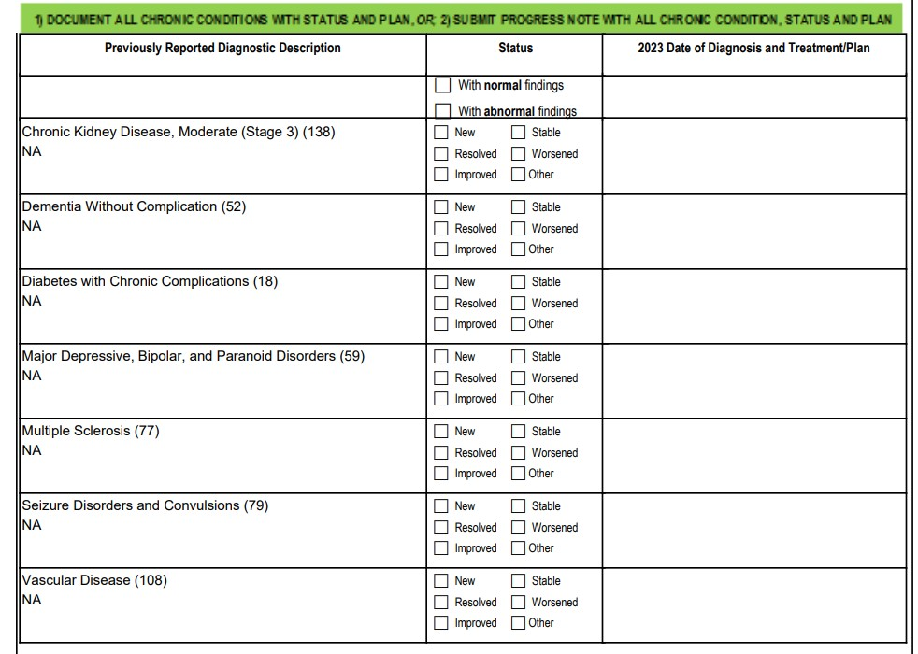
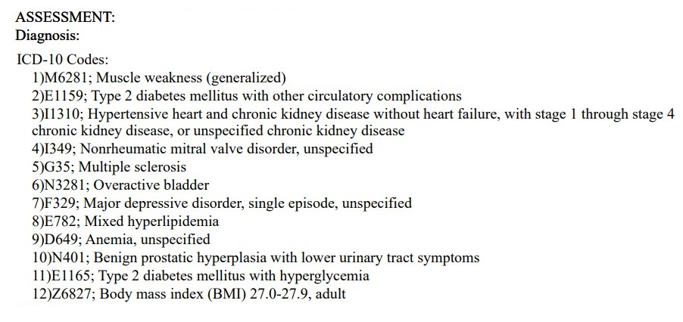
Shortage Report Item: Seizure Disorders
ADDRESSING THIS
WOULD’VE ADDED
1 POINT TO THE SCORE
MOVING IT TO………
78%
Section from the AWV form:
Assessment / Diagnosis Section from Progress Note:
Pg 3
IMPORTANT
GIVE MORE CLARITY IN
THE NOTES
fyi
Is muscle weakness a symptom of Multiple Sclerosis OR is it something more specific that involves seizures and convulsions?
If so: Code to highest specificity AND include NOTES
The shortage report is based on data from Health Plan including: Historical conditions and/or suspected conditions (data received from multiple provider sources, algorithm, etc.)

Slide 15
Shortage Report Item: Vascular Disease
ADDRESSING THIS
WOULD’VE ADDED 1 POINT
TO THE SCORE MOVING
IT CLOSER TO………
80%
Section from the AWV form:
Assessments Section from Progress Note:
Pg 3
The closest assessment code found in progress note for Vascular Disease, but NOT a capture of Vascular Disease
Diagnosis codes found in Claim:
IMPORTANT
IN YOUR PROGRESS NOTES, MAKE SURE TO
CLEARLY DOCUMENT THE CONDITIONS
The Assessment & Plan SUGGEST Vascular Disease, but Vascular Disease was not captured from codes. The chart is vague as to the presence of the actual condition. We need clarity and specificity.

Slide 16
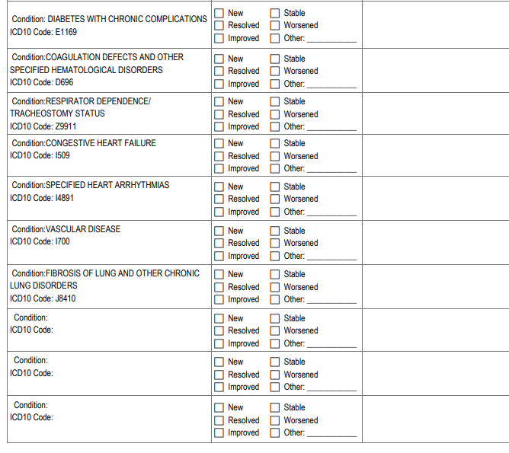
Medicare Annual Wellness Visits Section 1: chronic conditions
CONDITION STATUS NOTES
To improve YOY Recapture Rate for RAF, your biller must submit via CLAIMS the ICD-10 code(s)
Fax page with correct box checked along with notes to 818-817-5181

Slide 17
Review of Pre-filled AWV Review of Claims

Slide 18
SAMPLE AWV Claims – submit for each visit throughout the calendar year

Slide 19
First Page of AWV Form – Instructions

Slide 20
Example of 2023 Medicare AWV Form
Section I - Previously Reported Dx and Codes

Slide 21
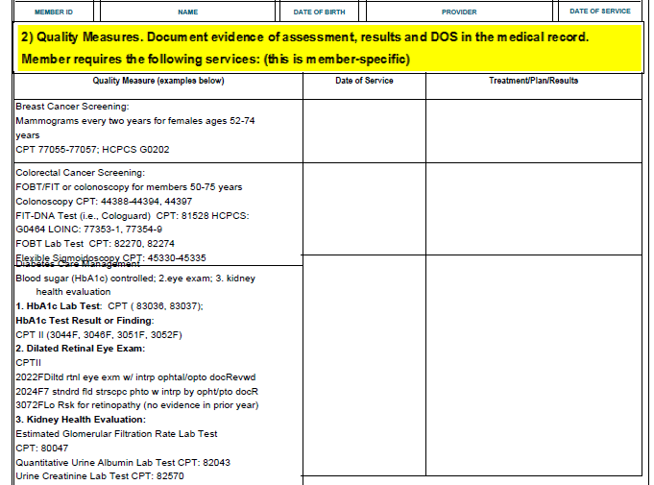
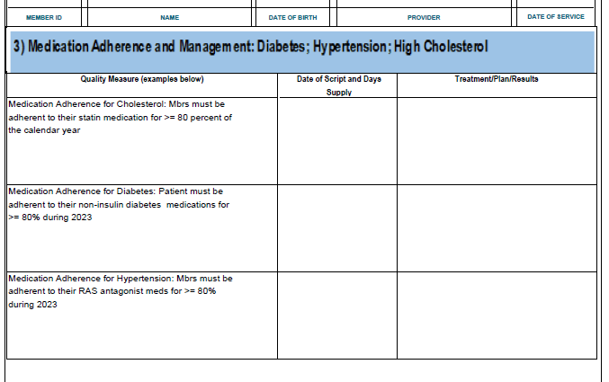
Example of 2023 Medicare AWV Form
Section 2 – Quality/HEDIS
Section 3 – Medication Adherence

Slide 22
Example of 2023 Medicare AWV Form

Slide 23
Example of 2023 Medicare AWV Form

Slide 24
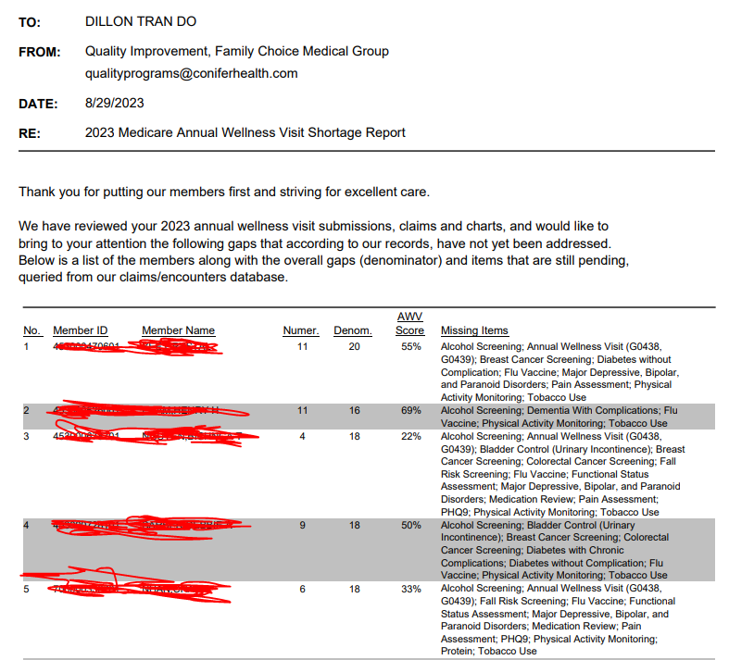
Medicare HMO AWV Shortage Report

Slide 25
CalOptima ONE Care Mock Audit Results

Slide 27
